Slide 1
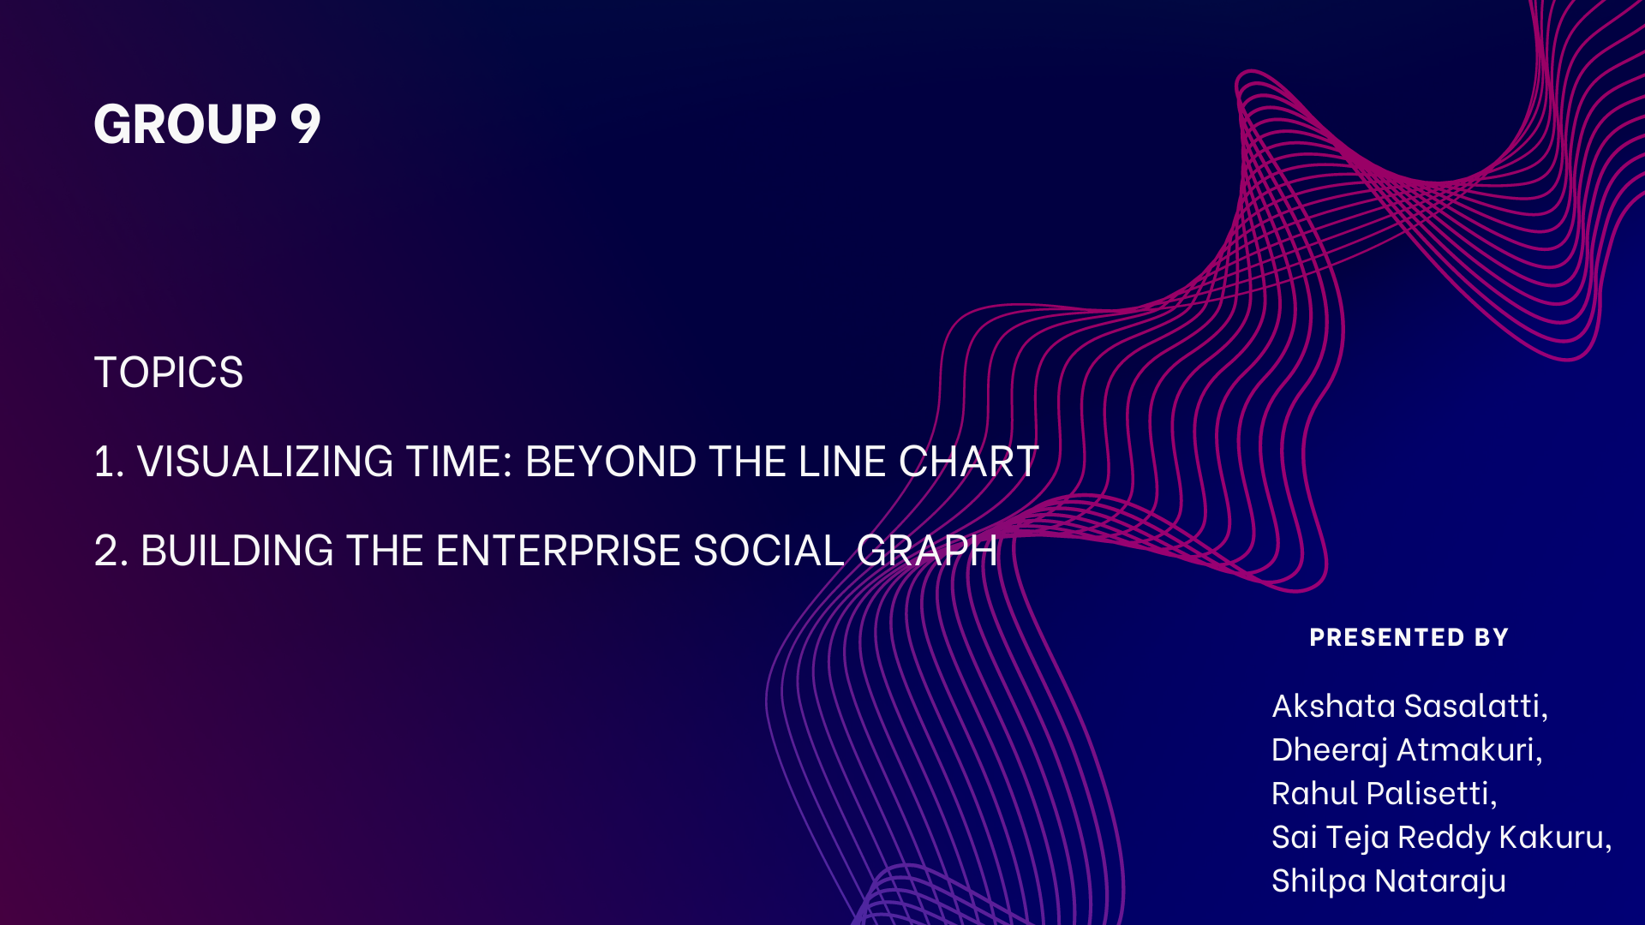

Slide 2


Slide 3

With visual analytics we often seek to discover what’s happening within our data over time. We also need to find insights as quickly as possible. So, what is the best way to chart time to get the most out of it?
Is the line chart always the best way to visualize time?
It depends.
TIME IS PRECIOUS

Slide 4
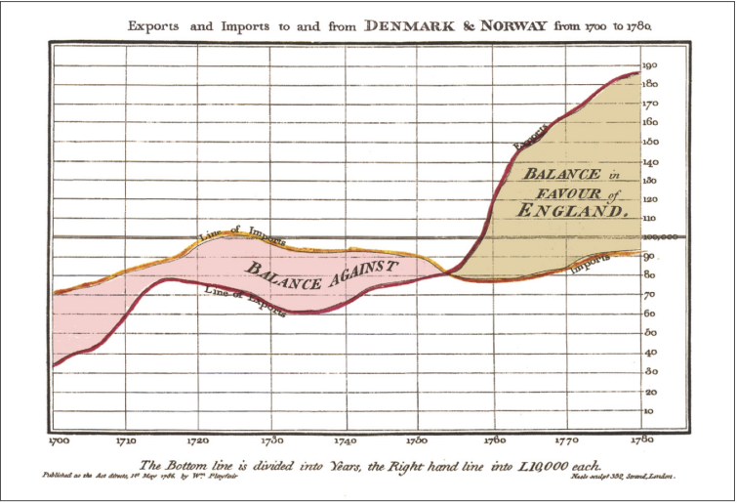
The first statistical line chart dates to 1786 when William Playfair visualized imports and exports between Demark, Norway and England.

Slide 5
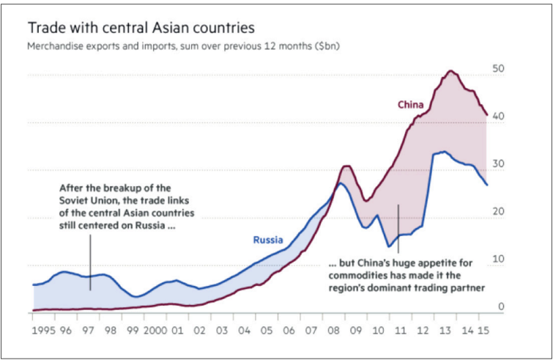
Even today, the line chart remains a valuable analytics tool, as seen in a nearly-identical 2015 Financial Times visualization about international trade.

Slide 6
Linear Timelines are Powerful
The lines’ heights, angles, and positions can tell many data stories. But line charts may not always be the best way to maximize our understanding of time.
In fact, there are many more ways to explore data and time, each potentially surfacing insights that would have remained hidden in a basic line chart.
Various chart types unveil slightly-nuanced perspectives, unknown unknowns, and even multiple truths in a single data set.
Here are three ways to cheat Benjamin Franklin’s ominous quote and expand your creative conversation with data and time
“Lost time is never found again” – Benjamin Franklin

Slide 7
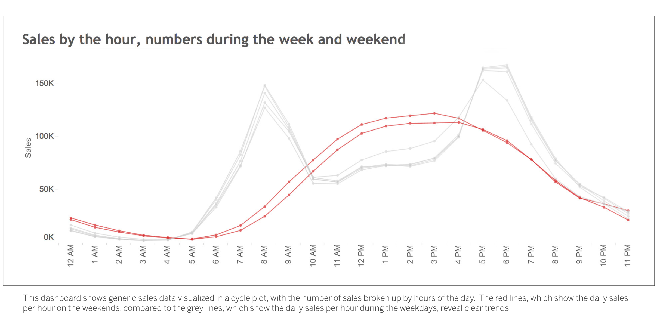
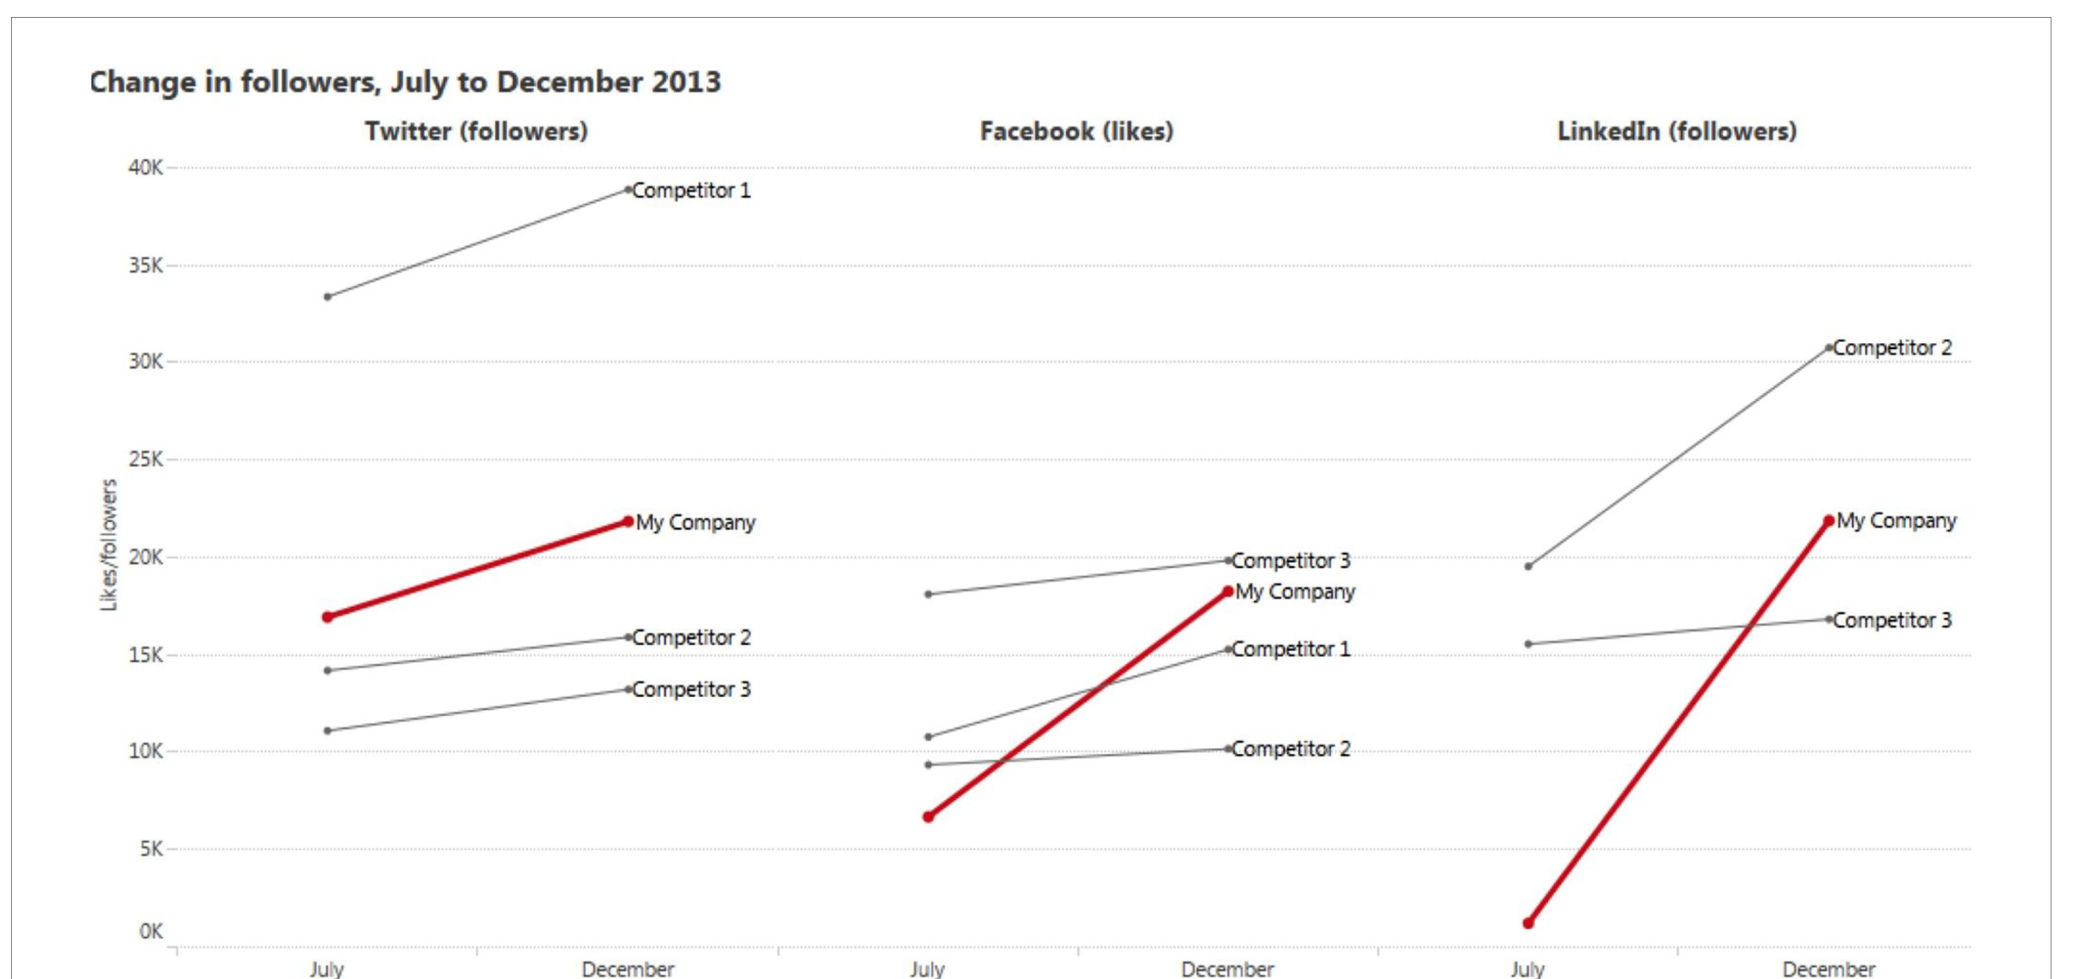
Exploring Alternative Charts for Time Visualization
Limitations of Line Charts: While line charts are valuable, they can sometimes be cluttered and may not effectively highlight important changes over time.
Introducing Alternatives: In the following slides, we'll explore three alternative visualization techniques - Slope Chart, Cycle Plot, and Highlight Table - that can provide clearer insights into time data.

Slide 8
Understanding Slope Charts The Slope Chart - From Start to Finish
Definition: A Slope Chart is a graph that displays the change in a value between two points in time, highlighting the start and end points while eliminating the distractions in between.
Benefits: Slope charts can reveal answers faster and provoke new questions by focusing on the change between two points.
Application: Marketers can use slope charts to visualize social media data, revealing insights about follower growth, brand-name mentions, engagement, and reach against competitors.
Uses of slope chart: Overall, slope charts are a versatile tool for visualizing and analyzing changes over time, making them a valuable asset in various fields such as business, economics, sports, and social sciences.
1. Visualizing Growth or Decline: Slope charts can effectively visualize growth or decline in metrics such as revenue, population, or market share over a specified period. 2. Identifying Outliers: They can help identify outliers or anomalies in data, such as a sudden spike or drop in a particular metric.

Slide 9
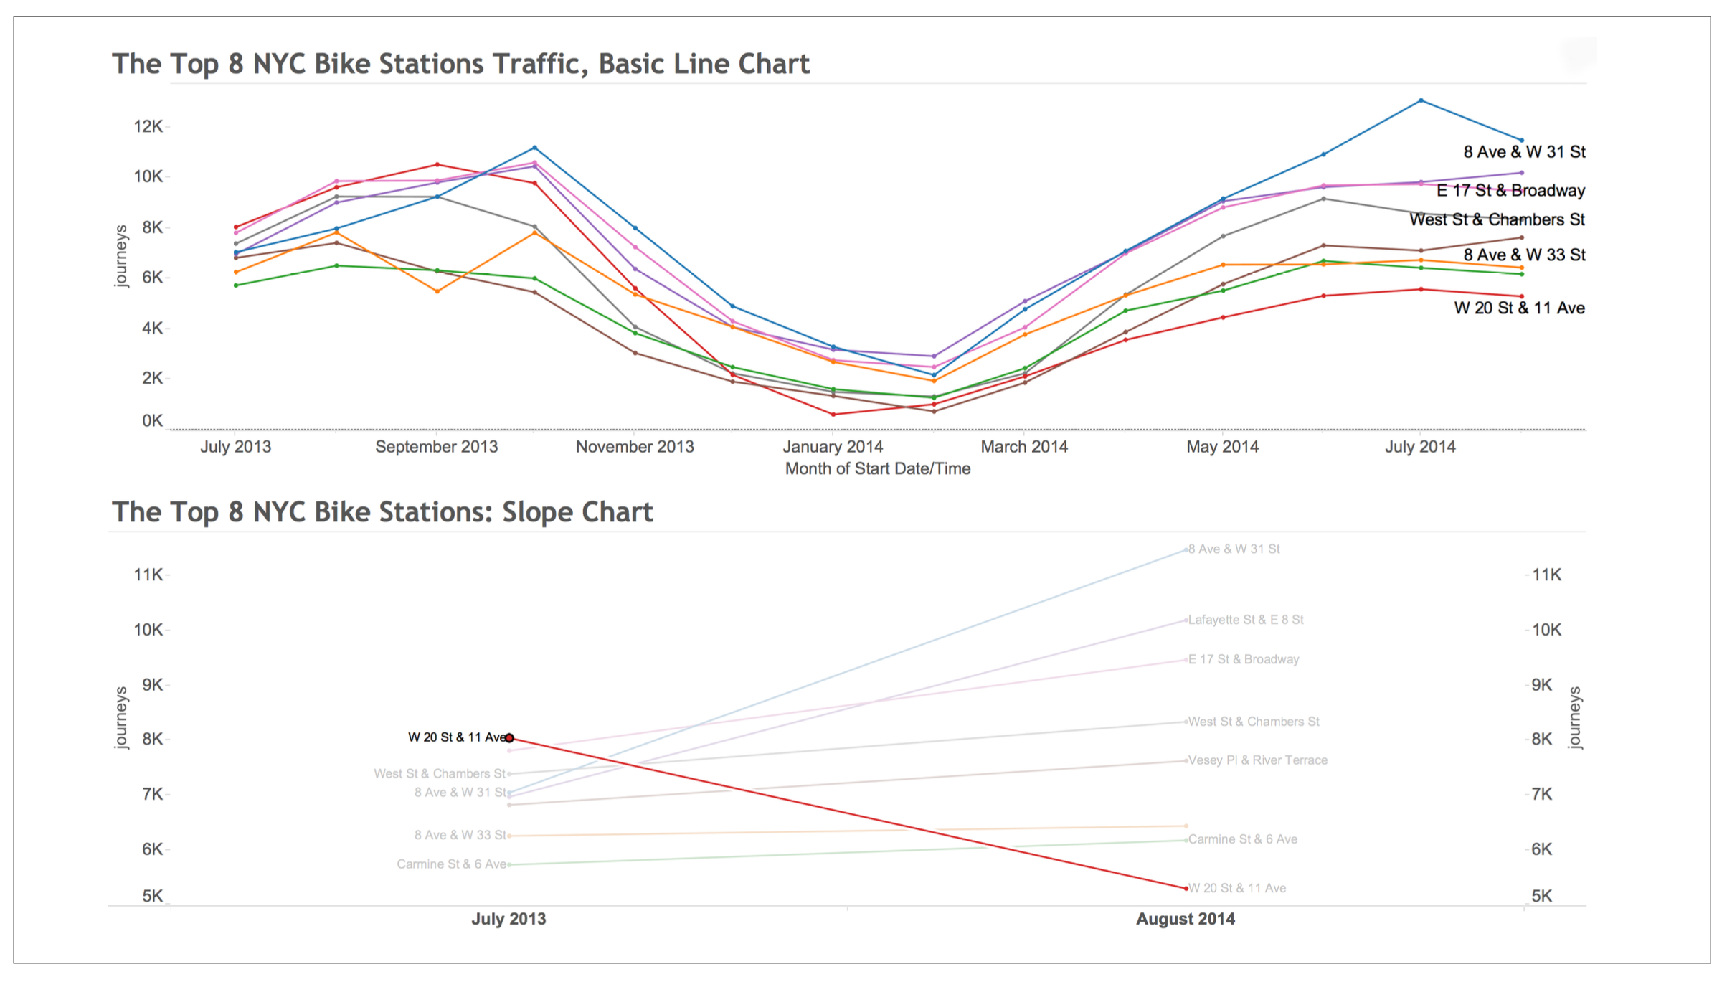
Comparison of top eight New York City bike stations over a year
Example of Slope Chart
Comparison of top eight New York City bike stations over a year shows that the W. 20th Street station went from the number one station to the number eight station, a significant change that is immediately apparent in a slope chart.

Slide 10
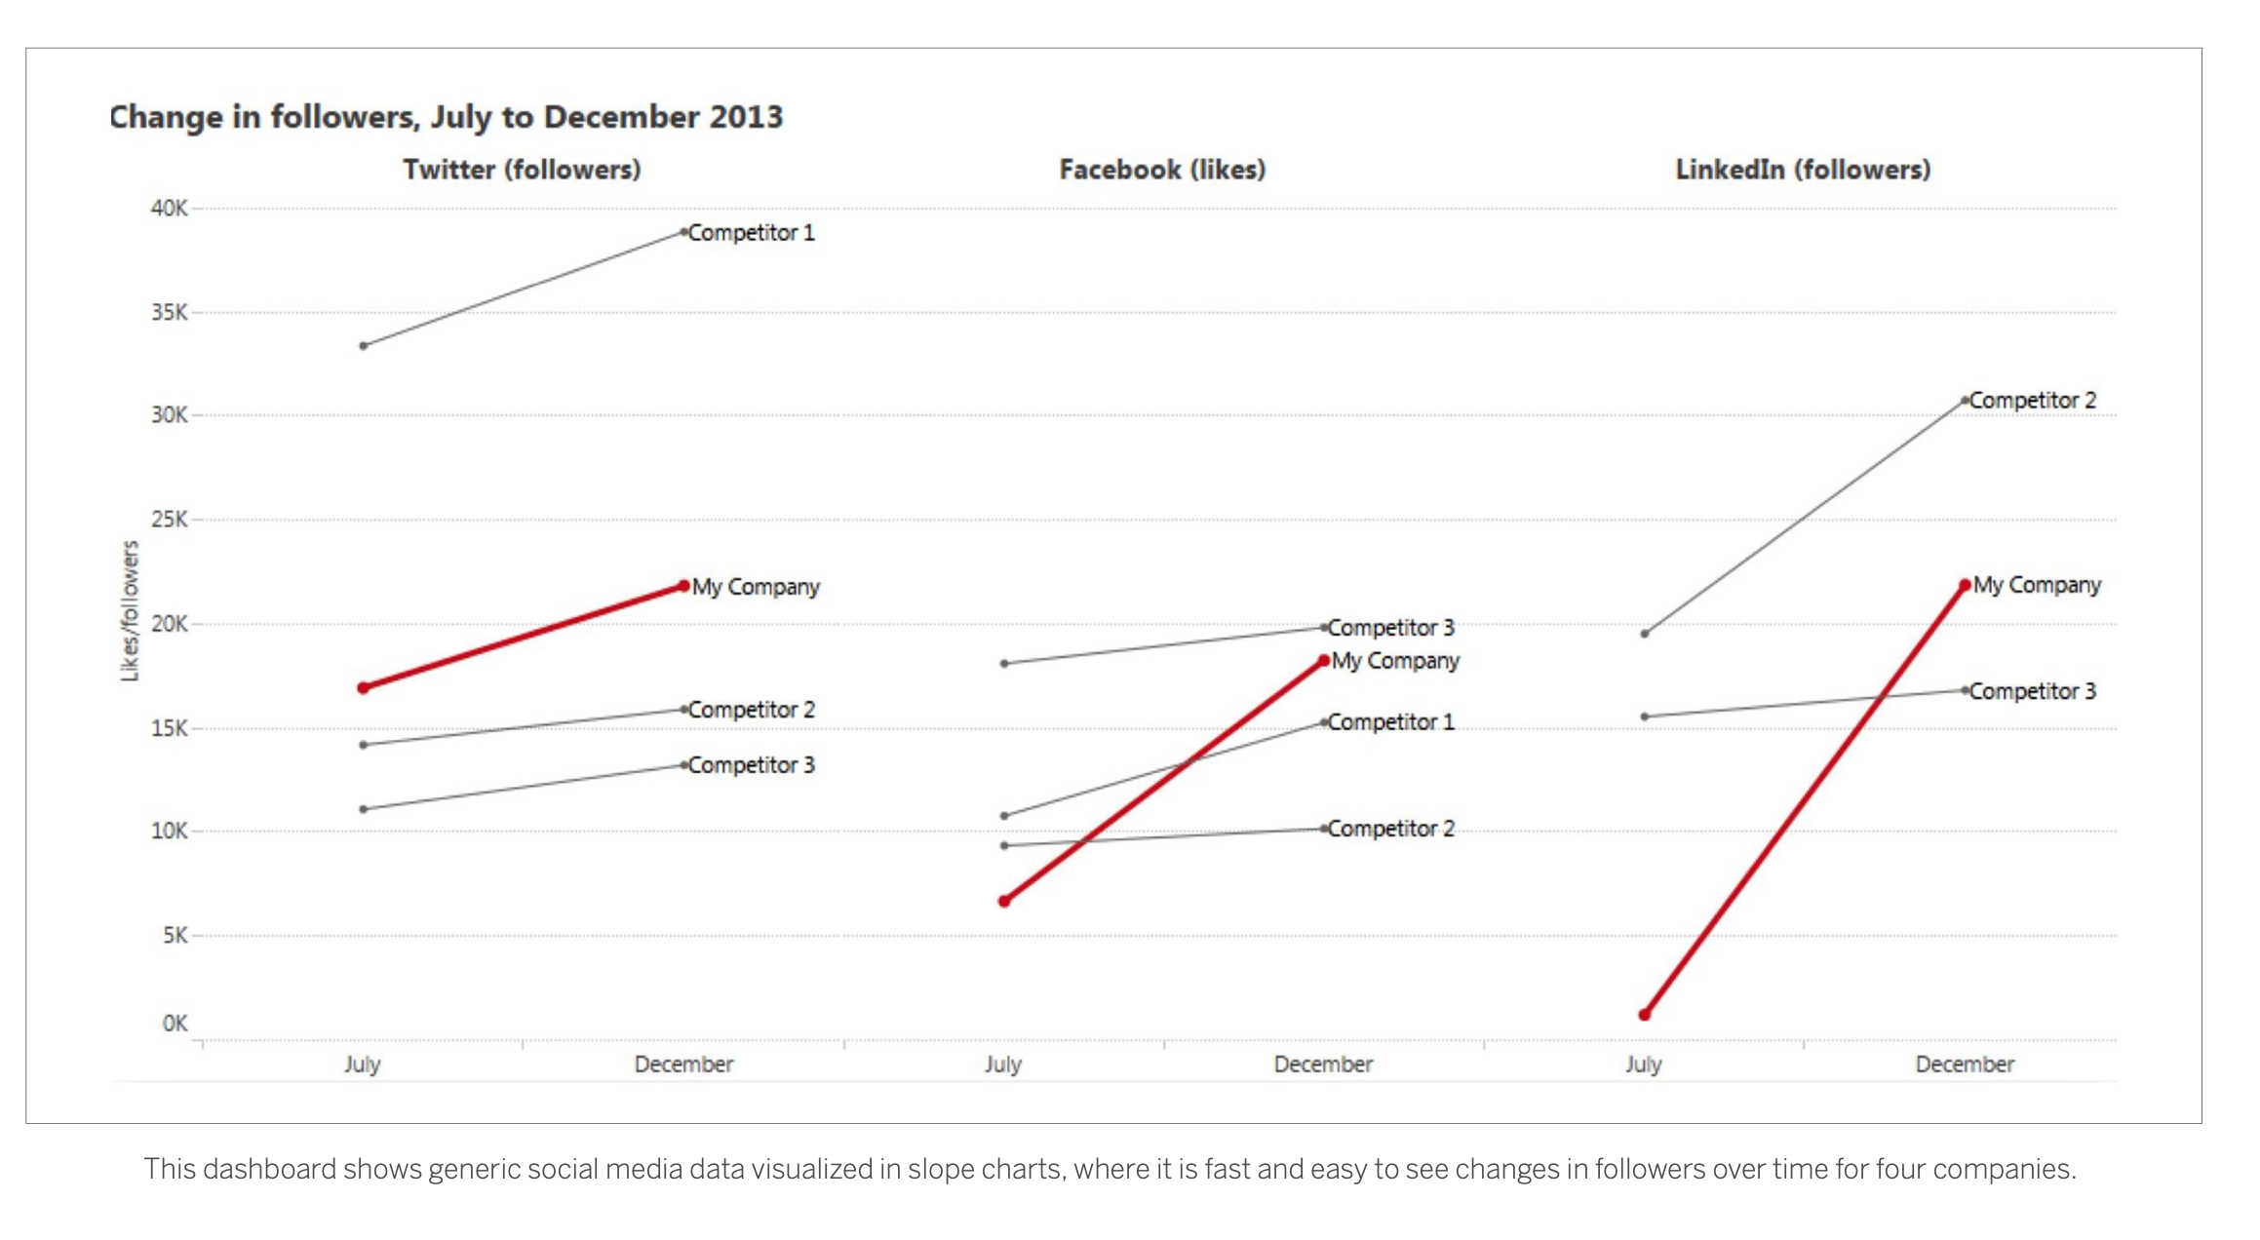
For marketers, using a slope chart to visualize social media data can reveal more insights about follower growth, brand-name mentions, engagement, and reach against competitors.

Slide 11
Exploring Cycle Plots Cycle Plots - Trends and Seasonality
Definition: Cycle Plots are graphical tools used to visualize seasonal or cyclical patterns within time series data, showing trends of different time periods simultaneously.
Benefits: Cycle plots can present more information at once, allowing for the comparison of trends over the whole time period as well as shorter periods.
Application: Real estate agents or sales reps can use cycle plots to quickly identify important trends just under the surface of their data, such as changes in sales on each weekday over the past six months or the best days of the week for closing deals.
Cycle plots are a specialized type of chart used to analyze time series data, particularly when the data exhibits seasonal, cyclical, or periodic patterns. Their uses span across various fields and purposes:
Identifying Seasonal Patterns: Cycle plots excel at uncovering seasonal trends in data, such as sales peaking during the holiday season or visitor numbers to a park increasing in summer.
Strategic Planning: For industries heavily influenced by seasonality, such as retail, tourism, and agriculture, cycle plots are crucial for strategic planning, helping to anticipate changes and prepare for future cycles.

Slide 12

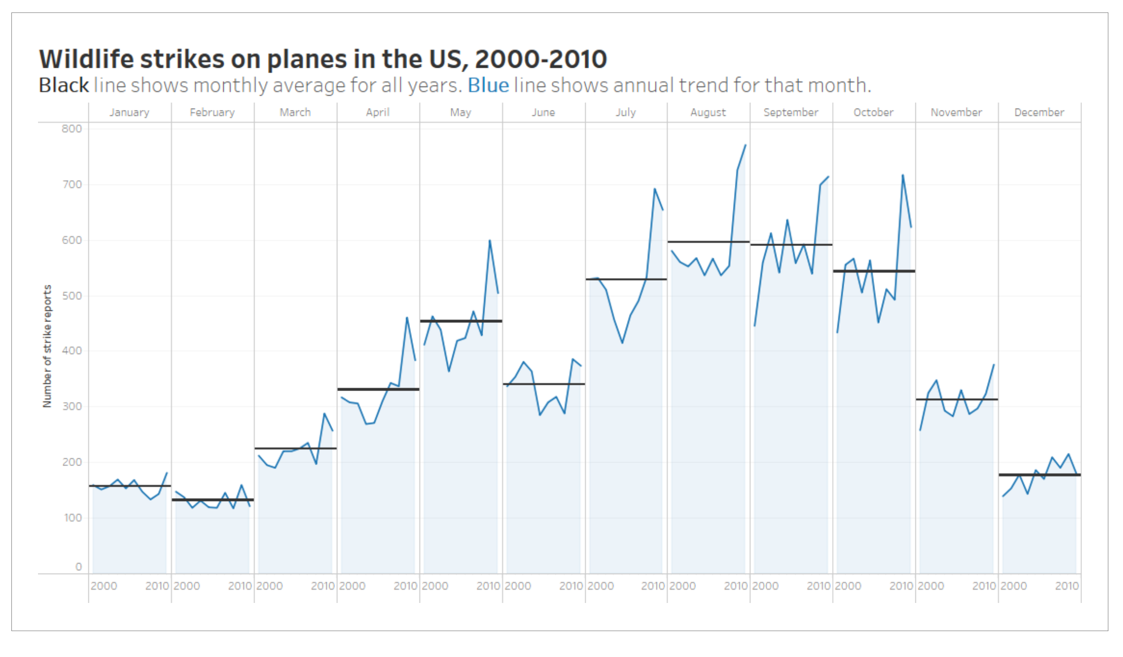
Visualization of ten years of wildlife strikes on airplanes in the US
Examples of cycle plots
Visualization of ten years of wildlife strikes on airplanes in the US reveals that bird strikes are far more common in August, September, and October than in other months.

Slide 13
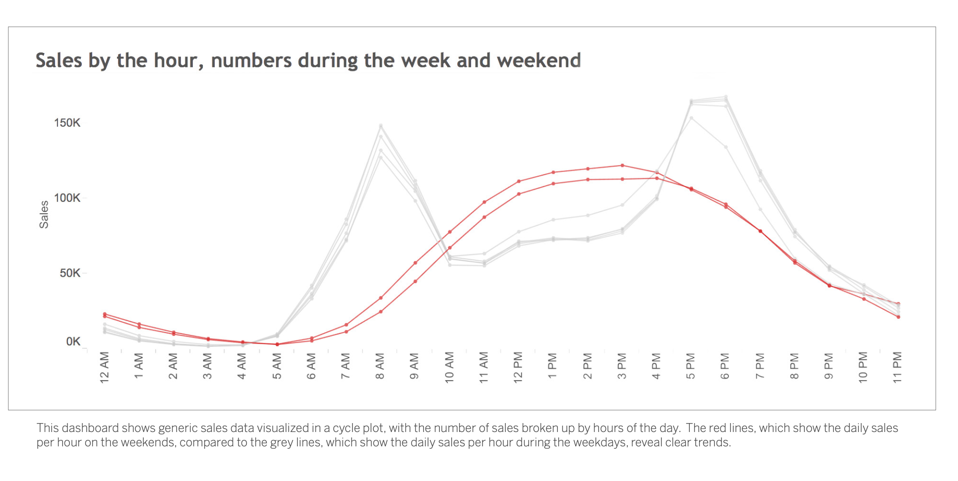
For real estate agents or sales reps, cycle plots can quickly show important trends just under the surface of your data. Cycle plots will answer questions like: How has sales changed on each weekday over the past six months? What days of the week in each month are better for closing deals? Or what hour of the day is the highest performing? Knowing this information can drastically improve quarter planning and seasonal decision-making.

Slide 14

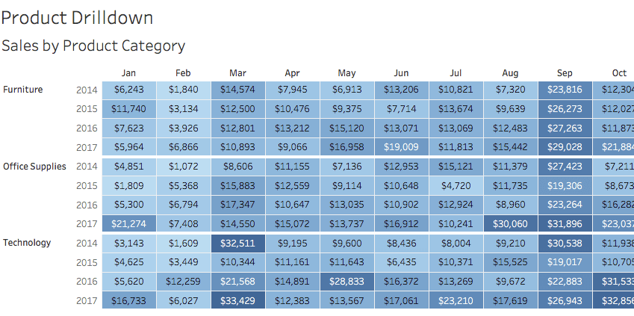
Highlight Tables: From Data to Insights
Highlight Tables - Highlight specific values or patterns within a large dataset through the use of colors. They present numerical values within each cell, offering a more detailed depiction of the data.
A highlight table uses color to grab the viewer’s attention while presenting precise figures.

Slide 15
Highlight tables serve as a critical tool for translating complex data into actionable insights. These tables provide a means to visualize data that emphasizes key metrics and patterns, making them essential for any data-driven decision-making process.
Highlight tables simplify complex datasets using color and font formatting to emphasize critical data points and comparisons. Unlike line graphs or bar charts that track trends or compare categories, highlight tables offer a focused yet context-rich overview, allowing for quick identification of significant patterns within dense data.
Benefits: Clarity and Speed The primary advantage of highlight tables is their ability to make significant data points stand out at a glance. This is particularly useful when rapid data assessment is needed, such as in business performance reviews or when identifying trends in large datasets.
Application: Versatility Across Fields Highlight tables are not industry-specific; they are versatile enough to be used across various fields such as finance, marketing, healthcare, and more. They help in tasks like tracking sales performance, monitoring patient statistics, or evaluating marketing campaign effectiveness.
Uses of Highlight Table: Comparative Analysis: Highlight tables are exceptional for comparing values across different categories or periods, offering a quick way to spot outliers or anomalies. Pattern Recognition: They simplify identifying trends within the dataset, such as consistent high or low performers.

Slide 16
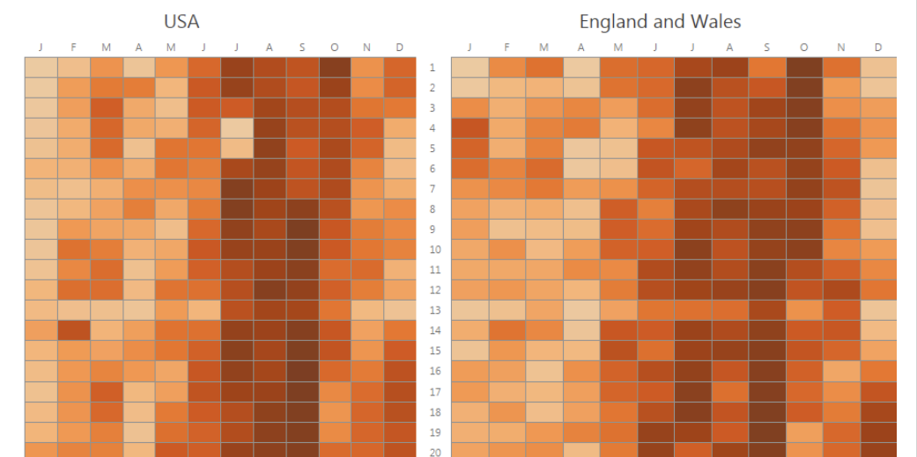
Example-1:- Common birth dates in the US compared to the UK Using both month and year, this highlight table shows how expected birth dates are in the US compared to the UK. The darker the color, the more familiar the birthday. You can look at individual dates as well as trends in the colors.

Slide 17
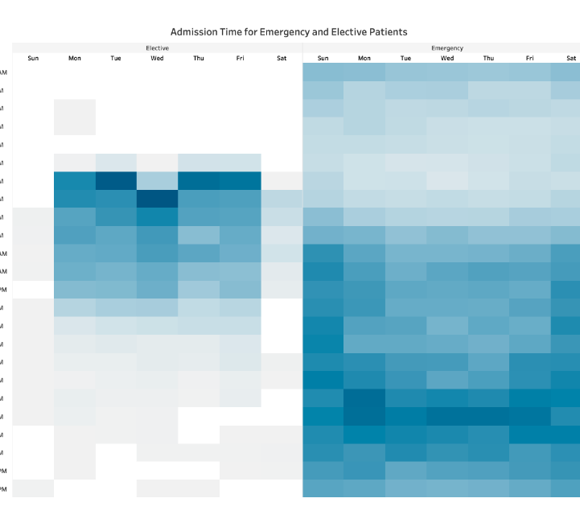
Example-2:- This table provides a snapshot of hospital admissions, showing the number of patients admitted and their corresponding wait times. Darker shades represent higher patient volumes in the waiting room.
The data is spread evenly. Viewers can see when more patients are waiting and when the waiting room might be empty.
Elective and emergency wait times are split into two tables but use the same color.

Slide 18
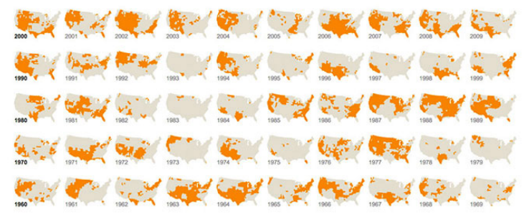
We can also use Highlight Tables to visualize the time data on a map to reveal the driest regions over time, like the New York Times did in this visualization.

Slide 19
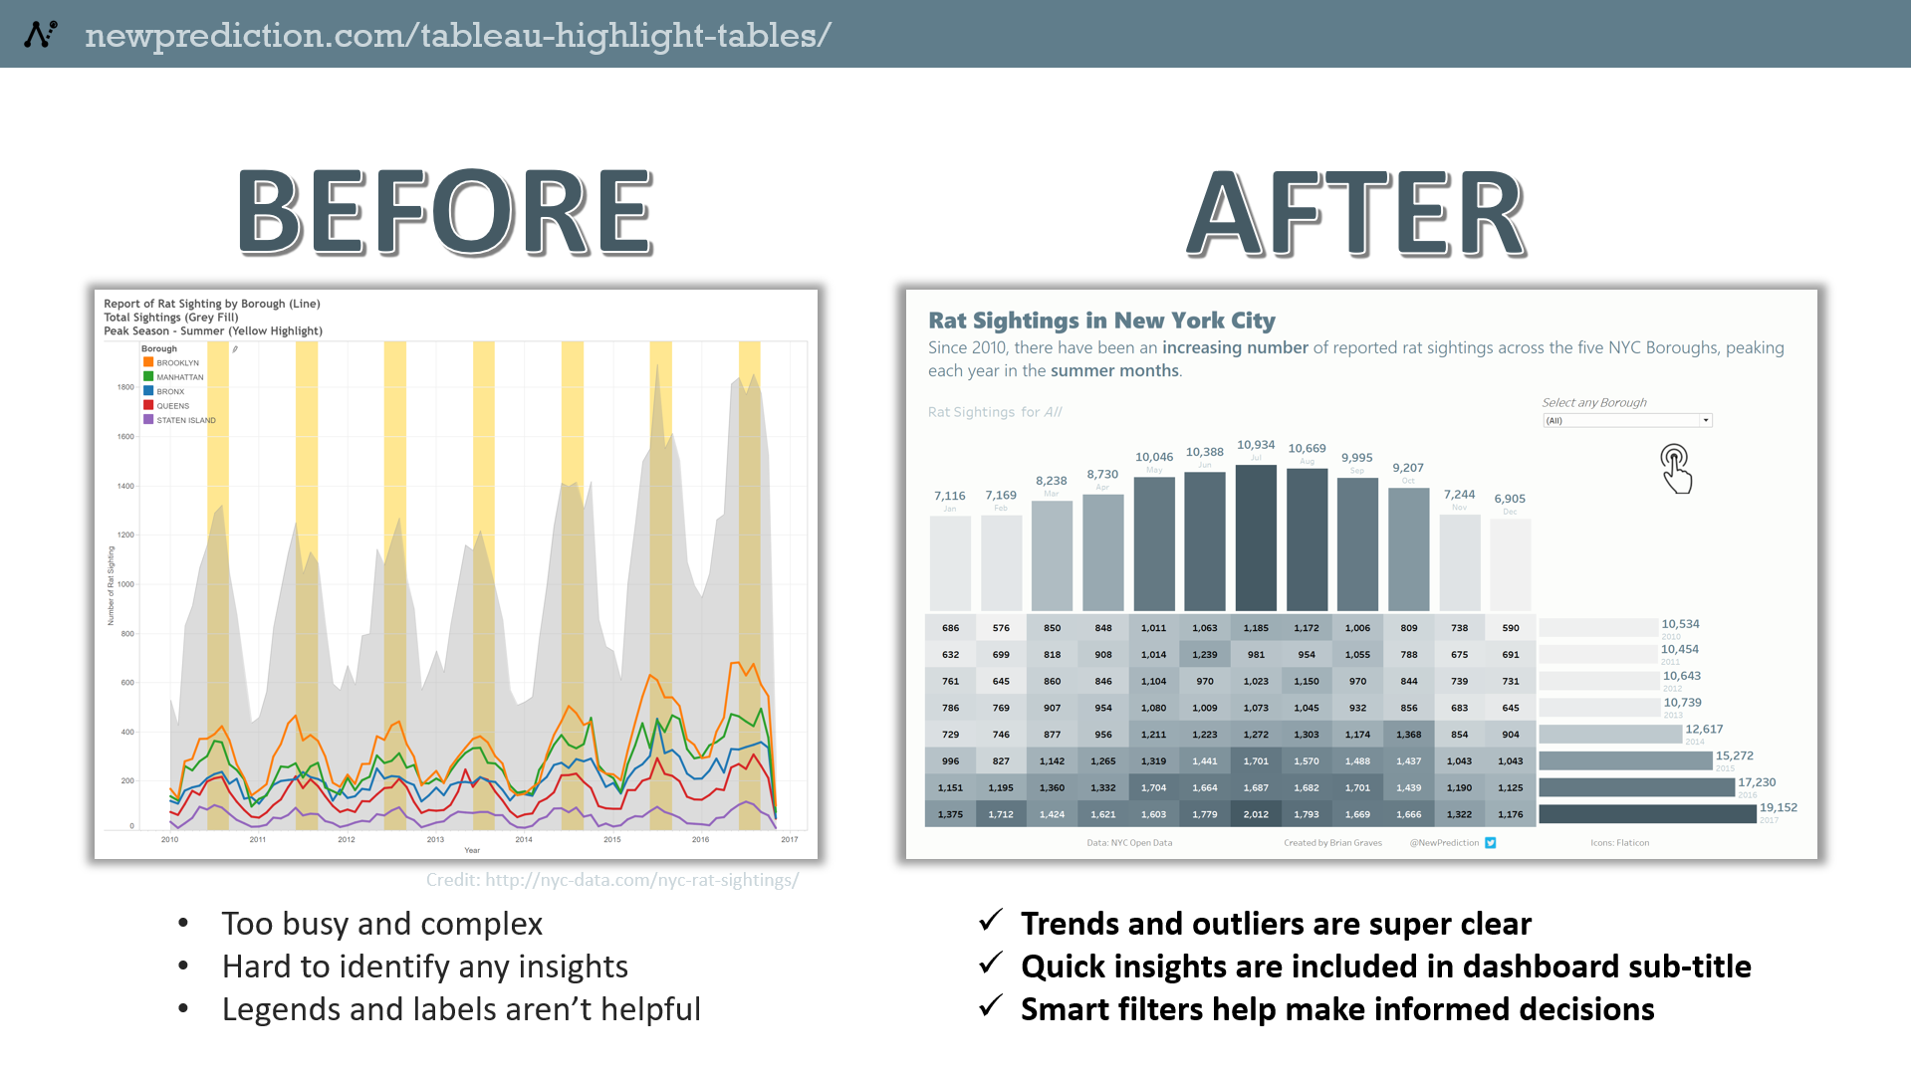
Rat Sightings in New York City

Slide 20
Learning Outcomes & Conclusion
The Effective visualization of time-based data extends beyond traditional line charts.
Slope Charts: Simplify data to show significant changes between start and end points, focusing on overall trends rather than detailed fluctuations.
Cycle Plots: Compare trends across different periods within the exact visualization, revealing underlying patterns and seasonality that might be missed in linear timelines.
Highlight Tables: Use color to encode data, allowing for quick identification of patterns and hotspots across two dimensions.
These visualization techniques provide unique perspectives that enable a clearer understanding of data, uncovering trends, patterns, and anomalies. Encourage the use of creative and innovative approaches to data visualization, expanding the possibilities for interpreting time-based information.

Slide 21

Building The Enterprise Social Graph

Slide 22
Learning Objectives
Understand the concept of an enterprise social graph and its significance in modern organizational dynamics.
Differentiate between centralized, decentralized (federated), and distributed (peer-to-peer) social graph architectures, and assess their respective pros and cons.
Understanding the concept of a social graph: Educate participants about what a social graph is, how it represents relationships between individuals or entities within a network, and its significance in the context of enterprise collaboration.
Exploring social graph technologies: Familiarize participants with various platforms and technologies available for building and managing enterprise social graphs, including APIs, frameworks and software tools.

Slide 23
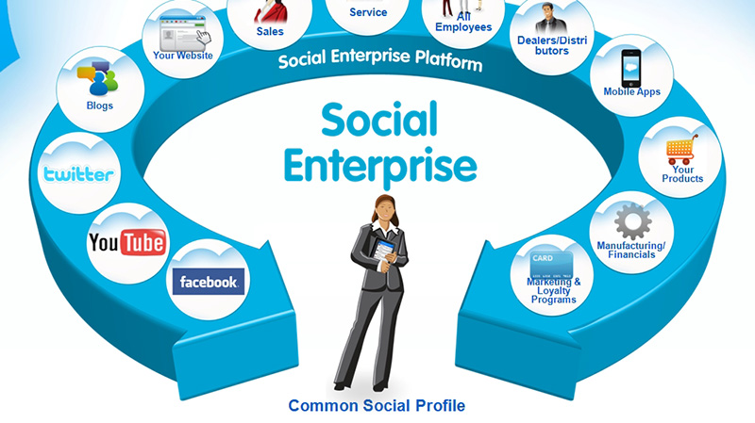
An enterprise social graph refers to a representation of the connections and relationships between individuals or entities within an organization. It's essentially a visual or digital mapping of collaborations and social interactions.
The term “social graph” originally gained prominence through social networking platforms like facebook or linkedin., where it referred to the interconnected web of relationships between users.

Slide 24
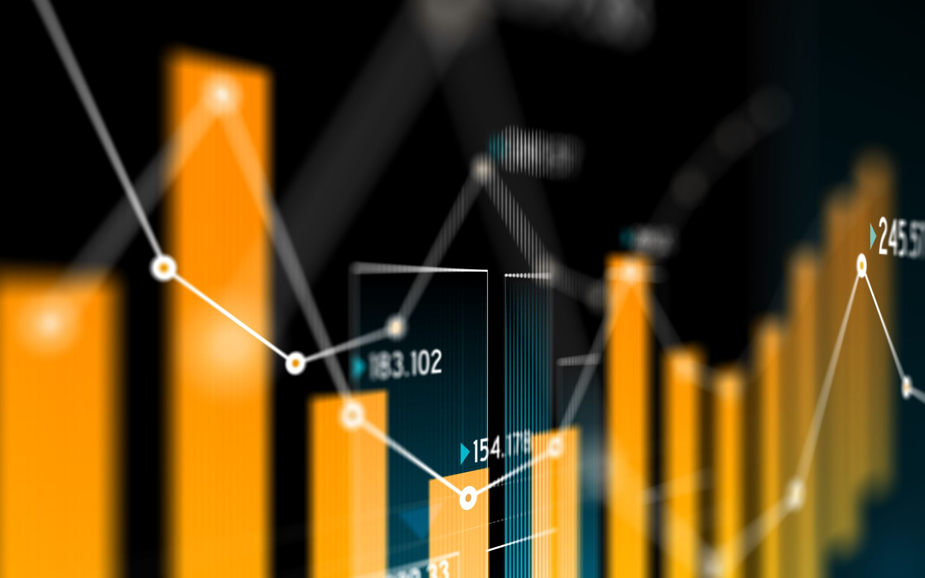
social graphs fall into three categories: Centralized, Decentralized (Federated), and Distributed (Peer-to-peer).
Centralized:
social media sites are run by gigantic tech companies like Meta, Google, Twitter, ByteDance, with Facebook getting the lion’s share. These platforms are centralized since all of your interactions are hosted in the company’s servers.
Pros:
Production and running costs are covered by platform’s owners in order to attract users in the first place
Cons:
Users don’t get a say in how the platform should be run or how profit is shared

Slide 25

Decentralized:
the decentralized networks operate on independently run servers and are usually powered by blockchain. Users can choose a server (service provider) to sign up with, and then have access to the entire network across many different servers. Case in point for the federated design is email protocol. You can sign up with Gmail and still can communicate with a Yahoo user or with anyone with an email address
Pros:
Users have more freedom of choices for applications, policies, and community cultures
Cons:
The production and running costs are split amongst a number of actors

Slide 26

P2P:
social graph, everyone’s device becomes a server that interoperates with others in the network. In this model, each node can work as both the owner and user. Some nodes may have special roles, like public bootstrap nodes that help new nodes join the network, but every node is still functionally equivalent.
Pros:
Enable users to move seamlessly across platforms without rebuilding their social graph at each destination.
Cons:
Burden of responsibility when it comes to recovering a lost or stolen password.

Slide 27
An enterprise social graph can be a valuable tool for organizations in various ways such as identifying experts and knowledge sources, enhanced collaboration, improving communication and decision making.
Building an enterprise social graph holds significant promise for collaboration, enhancing communication and knowledge sharing within an organization. Through the analysis of expertise, relationships and interactions among the employees, it fosters an efficient and more connected workplace environment.

Slide 28

Learning Outcomes
Understand what an enterprise social graph is and why it matters in today's workplaces.
Compare different types of social graphs (centralized, decentralized, distributed) and see what works best for different situations.
Learn how to use an enterprise social graph to find experts, see how teams work together, and improve communication.
See how using an enterprise social graph can make the company better - like by making people work together better and coming up with new ideas.
Get hands-on experience building, managing, and using an enterprise social graph using different tools.

Slide 29
Conclusion
In conclusion, the enterprise social graph serves as a dynamic representation of the interconnected relationships and interactions within an organization. By mapping out the social fabric of the company, it provides valuable insights into collaboration patterns, organizational structure, communication channels, and expertise distribution.
Leveraging the enterprise social graph can facilitate enhanced collaboration, improved communication, better talent management, and informed decision-making processes. Ultimately, it contributes to fostering a more connected and collaborative organizational culture, driving productivity, innovation, and employee engagement.

Slide 30
References
https://newprediction.com/tableau-highlight-tables/
https://medium.com/@ascendedpeak/introduction-to-tableau-highlight-tables-b64b96ba1e1b#:~:text=Unlike%20traditional%20line%20graphs%20or,from%20adjacent%20columns%20and%20rows.
https://www.tableau.com/learn/whitepapers/which-type-chart-or-graph-right-for-you-ungated
https://www.tableau.com/learn/whitepapers/visualizing-time-beyond-line-chart
https://www.forbes.com/2010/09/27/enterprise-social-media-technology-cio-network-woods.html

Slide 31
THANK YOU!

